Slide 1
Discussion 4
True Success, Physician Sentiment, and Implementation Science

Slide 2


Recap of Case Study
Your AI model has been deployed in the local hospital’s emergency department
Model automates the ordering of tests (this speeds up – and standardizes) how we deliver care
Model was validated with a 92% accuracy
Each group has a different model architecture, with different development and validation processes

Slide 3
Case Study Evolves
Your model has been deployed, but there has been some resistance from nursing staff and medical trainees in the emergency department…

Slide 4
Discussion 4 – Questions
Beyond technical knowledge, what are some potential emotional reactions, organizational structure, or cultural factors mediating incorporation of AI into clinical workflow?
How should impacts of AI tools on training processes be considered?
How can development teams collaborate with deployers to anticipate such factors at the start of a project and create plans to mitigate their impact?

Slide 5
TIME TO SHARE WITH THE LARGE GROUP
Share both overall thoughts – as well as those specific to your model’s architecture and validation process

Slide 6
LARGE GROUP DISCUSSION
Consider your model type in communicating your thoughts to the group
Model A
Model B
Non-Generative Model
Non-generative, Image-based Model
Model C
Model D
Multimodal Model
Generative Model

Slide 7
EVIDENCE & RESOURCES
In the following slides, we recommend relevant evidence and resources related to this discussion

Slide 8
Moving the Dial
A good model does not always improve care
ML Model Works
Model Integrated into Care
Model Improves Care

Slide 9
Implementation Science Strategies
[content to be added]

Slide 10
Creating Buy-In
Acknowledging threats to professional identity
Acknowledging emotional response to incorporation of new technology

Slide 11
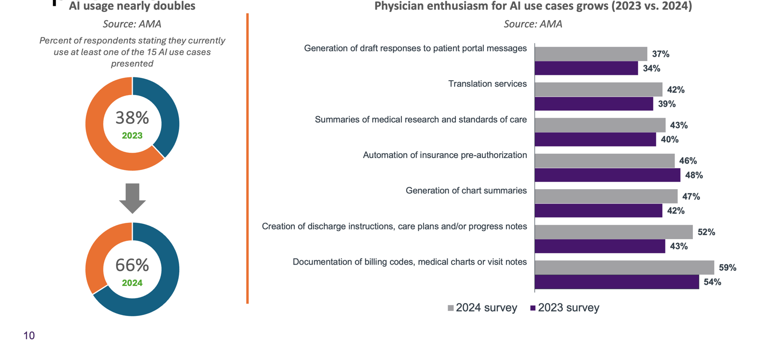
Physician Sentiment Toward AI Trending Positively

Slide 12
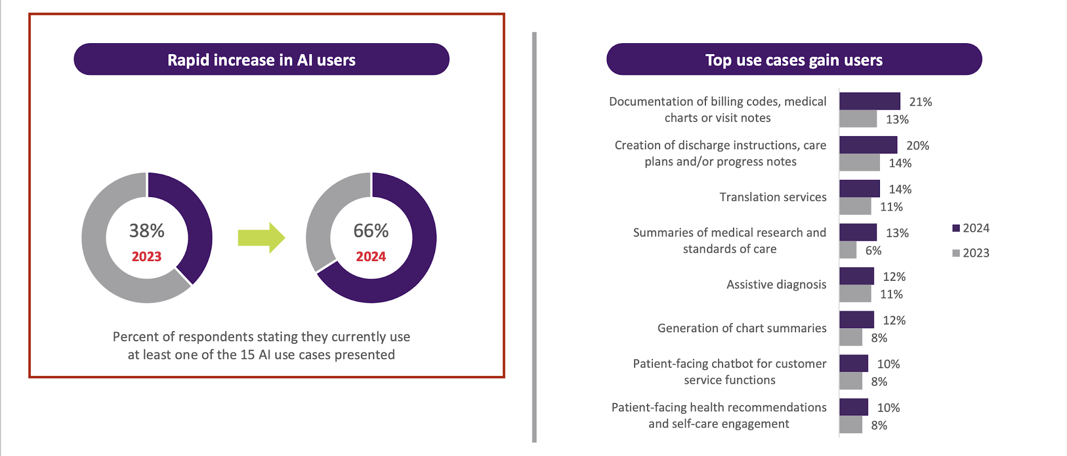
AI Usage Among Physicians Nearly Doubled Between 2023-2024

Slide 13

Precision Education
Find out more!

Slide 14
Relevant Readings
Liu, X., et al. (2019). Reporting guidelines for clinical trial reports for interventions involving artificial intelligence: the CONSORT-AI extension. Nature Medicine, 26, 1364–1374.
Cabitza, F., Rasoini, R., & Gensini, G. F. (2017). Unintended consequences of machine learning in medicine. JAMA, 318(6), 517–518.
Sendak, M. P., D’Arcy, J., Kashyap, S., Gao, M., Nichols, M., Corey, K., & Ratliff, W. (2020). A path for translation of machine learning products into healthcare delivery. npj Digital Medicine, 3(1), 1–4.

Slide 15
GOALS
Mars
Jupiter
Saturn
Despite being red, Mars is actually a very cold place
It’s a gas giant and the biggest planet in the Solar System
Saturn is composed mostly of hydrogen and helium

Slide 16
METHODS
Study
Hypothesis
Report
Problem
Data Collect
Experimentation
Venus is the second planet from the Sun
Saturn is the ringed one and a gas giant
Earth is the planet where we live on
Mercury is the smallest planet
Despite being red, Mars is a cold place
Jupiter is the biggest planet of them all

Slide 17
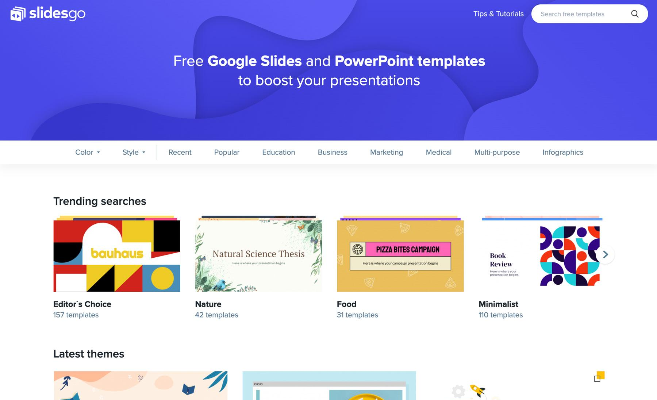
DESKTOP SOFTWARE
You can replace the image on the screen with your own work. Just delete this one, add yours and center it properly

Slide 18
ALTERNATIVE RESOURCES

Slide 19
RESOURCES
Microscope in a clinical laboratory
Woman scientist with microscope
Medical infographic female and charts
Technology background
Human body system collection
Medical infographic woman and man charts

Slide 20
THANK YOU FOR PARTICIPATING
Time for another discussion!

